Slide 1

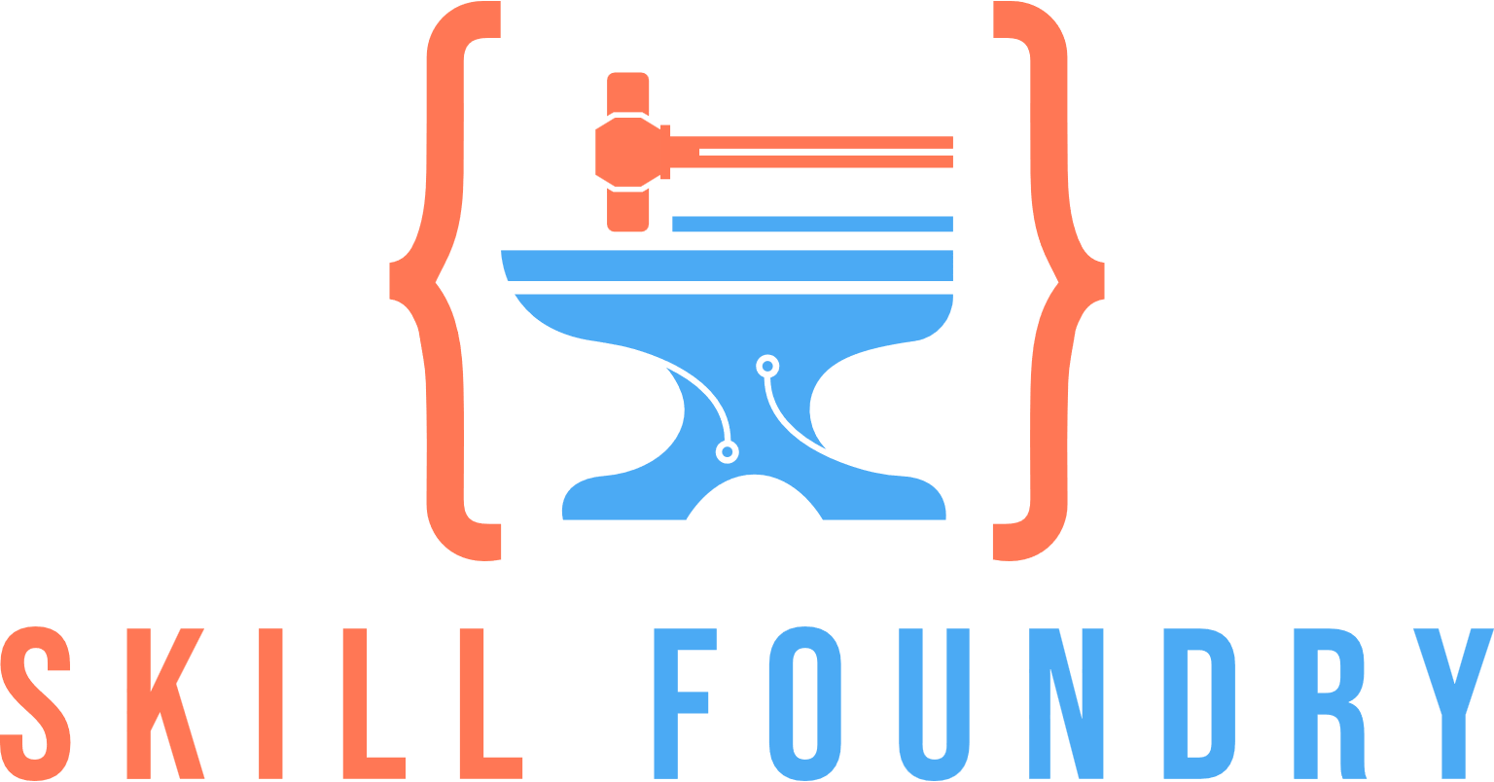
BEYOND LEETCODE: REDESIGNING TECH INTERVIEWS FOR THE AI-ASSISTED ERA
ERIC WISE
SKILL FOUNDRY

Slide 2

BEYOND LEETCODE: REDESIGNING TECH INTERVIEWS FOR THE AI-ASSISTED ERA
ERIC WISE
SKILL FOUNDRY

Slide 3




LEVEL 20 TECHNICAL EDUCATION ARCHITECT
Alignment: Chaotic Good
CORE STATS
PROFICIENCIES
FEATS
BACKSTORY
STR: 14 (Racking servers)
DEX: 16 (Types faster than Mavis Beacon)
CON: 8 (Type 2 Diabetic)
INT: 17 (Technomancy)
CHA: 16 (Inappropriate Jokes)
WIS: 18 (Explaining Sh...Stuff)
Assessment design and delivery
Learning Program Development
Technical Curriculum Creation
Hiring Process Analysis
Master of Scale (+2 to training program efficiency)
Career Alchemy (+3 efficacy to career-changers)
Thousands of successful career placements
Hundreds of hiring process observations
Multiple enterprise training program launches

Slide 4




CALIBRATION
1
2
3
Have you looked for a job in the last 24 months?
Have you been involved in the hiring process on the employer side?
Have you had formal training on interviewing?

Slide 5

WHAT’S HAPPENING IN THE MARKET?
Action
Consequence
AI is added to ATS systems
1.
1.
Employers increase candidate friction
AI tools cheaply available
2.
2.
Candidates start using tools to sidestep friction
Unqualified candidates enter the fray
3.
3.
Unqualified candidates use tools to spam applications
Employers overloaded with unqualified applications
4.
4.
Return to Step 1
The result: Good candidates get lost in the shuffle.

Slide 6


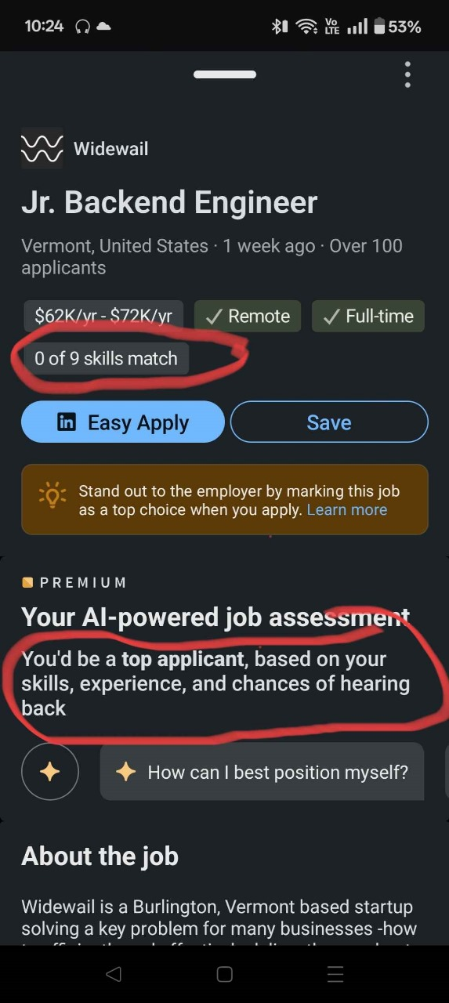


TECH INDUSTRY IS THE ONLY WINNER
This problem was created by tech companies.
They’ve monetized the pain from both employers and candidates.

Slide 7
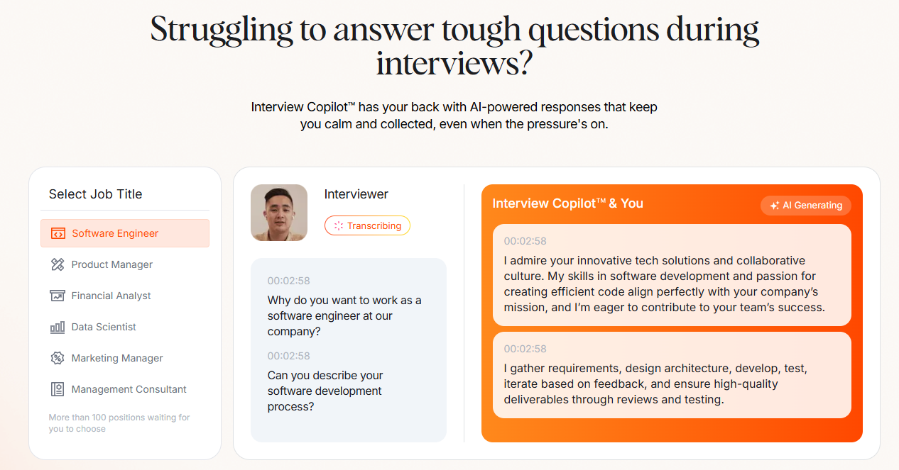

01.
Academic credential inflation
02.
AI-powered filter manipulation
03.
AI-powered interview deception tactics
THE FUNNEL IS BROKEN!
04.
Current issues:
Trivia-based assessment and take-home coding problems are no longer effective

Slide 8





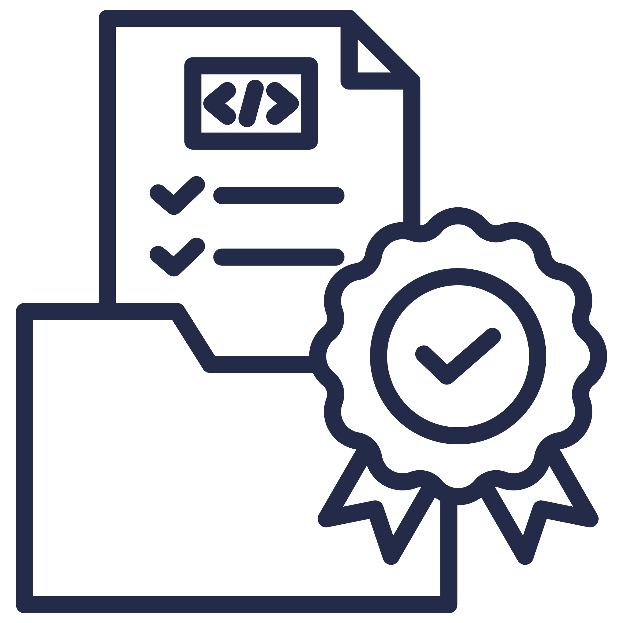


KEY TRAITS FOR THE AI ERA
AI tools are here to stay. Here’s what we want from candidates:
“Last-mile” code completion capabilities
System-level understanding
Security awareness
Performance optimization
Product/UX design consideration
Code verification skills
Effective communication skills
Growth mindset

Slide 9





Transparency over deception
While there is value in producing results, we value honest discussion about our tools, capabilities, and methods more.
Understanding over blind acceptance
THE AI TOOLS MANIFESTO
While there is value in leveraging AI tools, we value comprehending and taking responsibility for the code more.
Appropriate tool usage over over-reliance
We value:
While there is value in automation and efficiency, we value knowing when to apply human judgment more.
www.skillfoundry.io
Craftsmanship over expedience
While there is value in rapid development, we value using our gained efficiency to elevate the quality of our work more.

Slide 10





REFRAMING THE INTERVIEW PROCESS
Embracing AI as a tool, not a threat
Focus on process over memorization
Value authentic technical discussions
In-person interviews with oral defense

Slide 11

REAL-WORLD ASSESSMENT TECHNIQUES
01.
02.
Job-relevant focus
Pair programming with AI tools allowed
03.
04.
System design discussions with real constraints
Code review exercises
05.
06.
Debugging scenarios
Domain knowledge discussions

Slide 12


EVALUATING AI PROFICIENCY
RED FLAGS
GREEN FLAGS
Unable to explain code or design decisions
Openly discusses AI tools and has a rational methodology for use
Over-reliance of AI tools for basic programming concepts
Focuses on process and core logic while using AI for boilerplate and repetitive tasks.
Accepting AI responses verbatim without critical evaluation
Can explain and modify AI suggestions
Limited understanding of AI’s limitations or potential risks
Is mindful of user experience, security, and architectural fit for generated code
Shares sensitive information with AI tools without consideration
Shows discipline in testing and verification of generated code

Slide 13

IMPLEMENTATION STRATEGY
Continuous Improvement Process:
Hypothesis
Experiment
Form theories about what makes a good interview
Identify specific changes to test
Get stakeholder buy-in for experiments
Set clear success criteria
Train interviewers on new techniques
Run parallel processes where possible
Document everything
Gather feedback from all participants
01
02
Adjust
Measure
Review what worked/didn't work
Refine the process
Share learnings
Start next cycle with new hypothesis
Track key metrics
Collect candidate feedback
Monitor team satisfaction
Evaluate quality of hires
Compare against baseline
04
03

Slide 14



Standardized Human-Verified Credentialing System
Three-tier assessment framework (Junior/Mid/Senior)
Time-saving benefit for candidates
Spam reduction through verified digital credentials
Industry-wide recognition potential
Professional Organization/Union Development
Advocate for fair assessment practices
Set industry standards for AI tool usage
Protect worker interests in evolving landscape
Create community-driven certification standards
Provide reskilling and upskilling
TRANSFORMATION AND DISRUPTION

Slide 15





THANK YOU! (AND Q&A)
Contact Information
hello@skillfoundry.io
https://youtube.com/@skillfoundryio
skillfoundryio
https://www.linkedin.com/in/ericswise/

